Slide 2
SOEN 6441 – BUILD 3 WARZONE GAME
MADE BY TEAM 15
AMIR ASIF (40290282)
HEEBA SHAIKH (40278184)
JAIWANT SINGH MAHUN (40270569)
MEHAKVEER SINGH (40293616)
PANKAJ KUMAR SHARMA (40269802)
PUNAMKUMAR VEKARIYA (40290462)

Slide 3
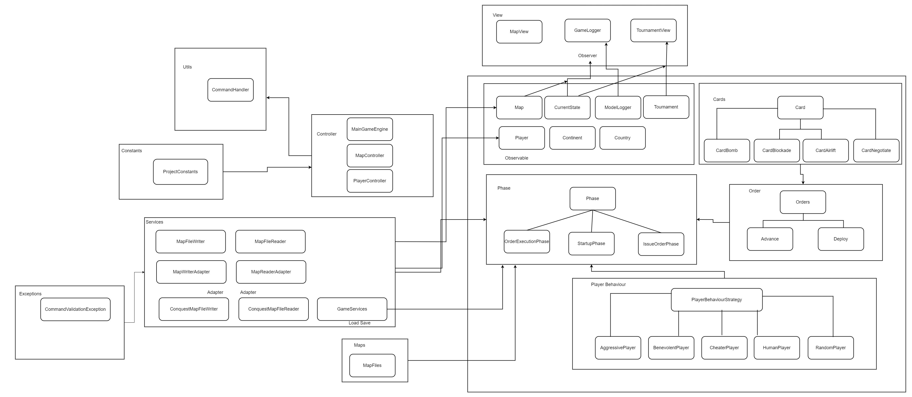
OUR DESIGN (Architecture Diagram)

Slide 4
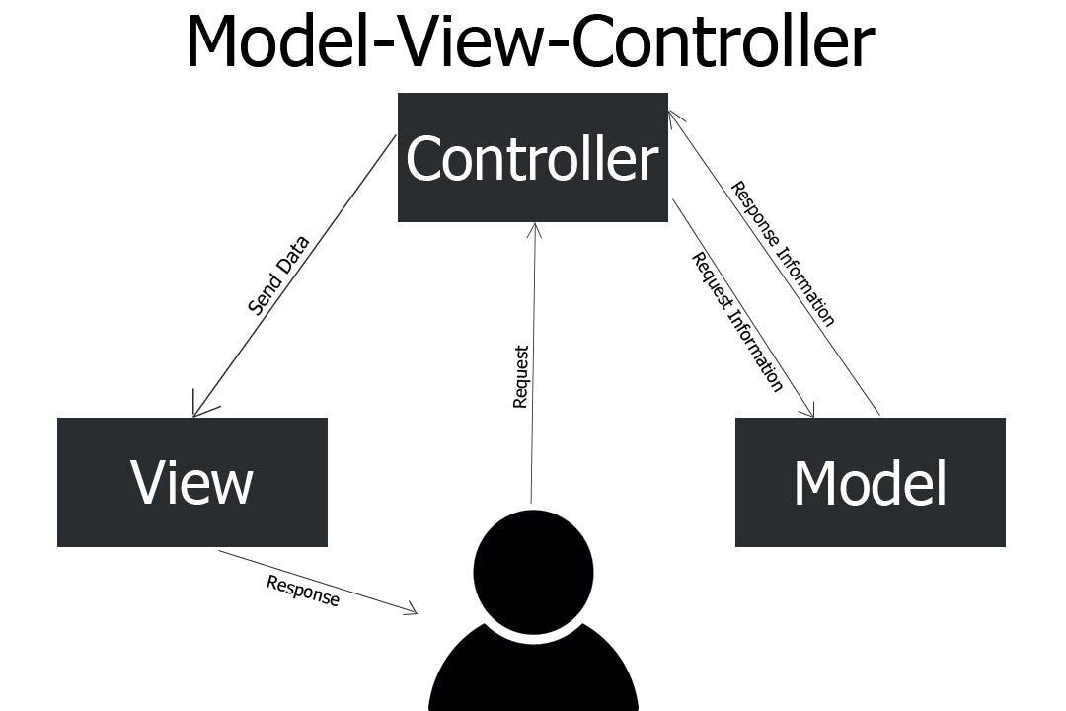
Architectural Design
Model It represents the business layer of application. It is an object to carry the data that can also contain the logic to update controller if data is changed.
View It represents the presentation layer of application. It is used to visualize the data that the model contains.
Controller It works on both the model and view. It is used to manage the flow of application, i.e., data flow in the model object and to update the view whenever data is changed.

Slide 5
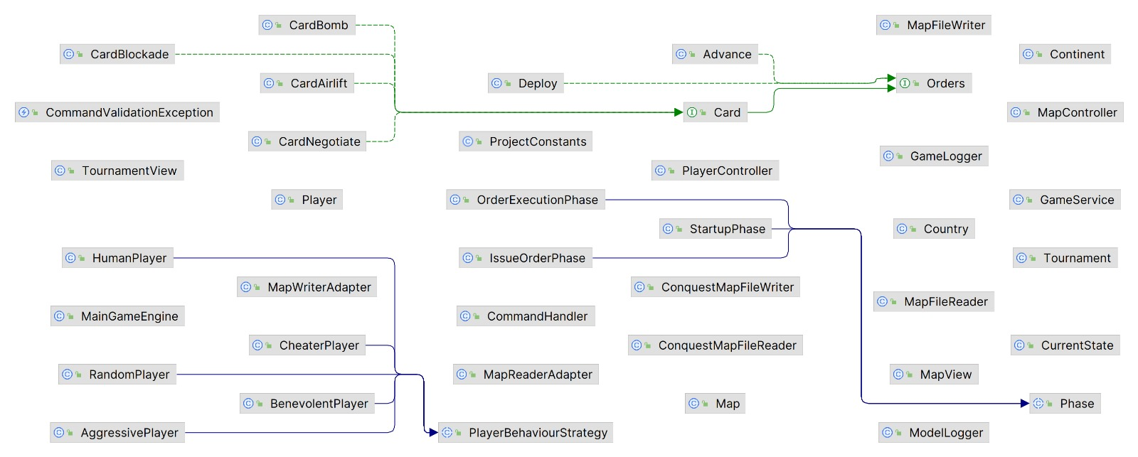
Class diagram

Slide 6
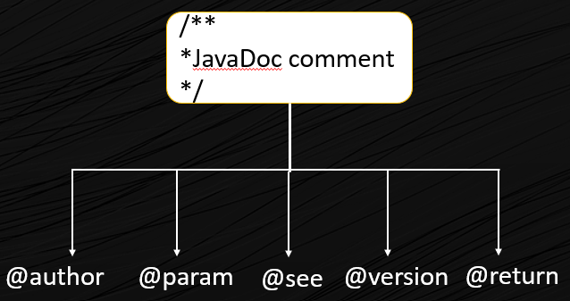
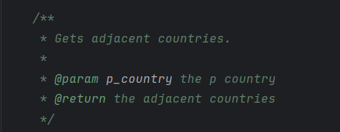
JAVADOCS
It is a document generator tool in Java programming language for generating standard documentation in HTML format. Declarations generates API documentation. It parses the ad documentation in a set of source file describing classes, methods, constructors, and fields.

Slide 7
NAMING COVENTION
Data Members, Member Functions & Methods Parameter
All are in lower camelCase like int addCountryNeighbour (int p_neighbourID)
And data members like int d_countryName
Classes
Class names are in upper CamelCase like
MainGameEngine.java
Local Variables
They follow lower camelCase along with "I_." stating it is a local variable like
boolean l_isPresent = true;
Static Members/Constants
All static members are in UPPER_SNAKE_CASE letters with underscores in between the words like VALID_MAP = "Map is Valid"

Slide 8
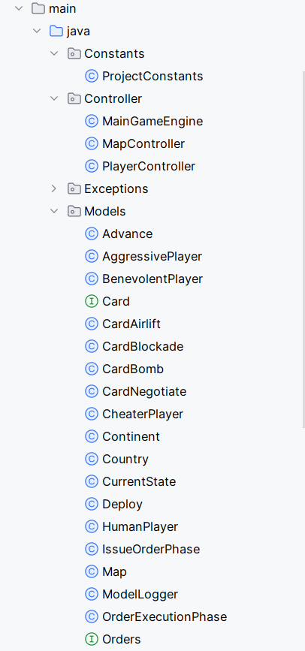
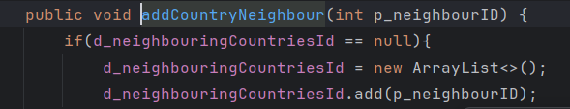
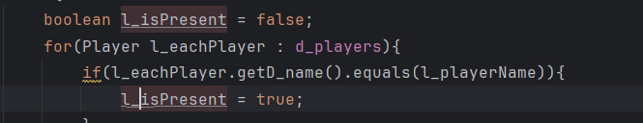
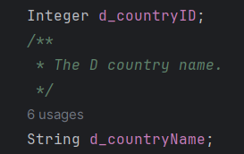
EXAMPLES OF
NAMING COVENTION

Slide 9
Architectural Design – Observer Pattern
The elements of observer pattern are as follows:
Subject - interface or abstract class defining the operations for attaching and de-attaching observers to the client. It is often referred to as “Observable”.
ConcreteSubject - concrete Subject class. It maintains the state of the observed object and when a change in its state occurs it notifies the attached Observers. If used as part of MVC, the ConcreteSubject classes are the Model classes that have Views attached to them.

Slide 10
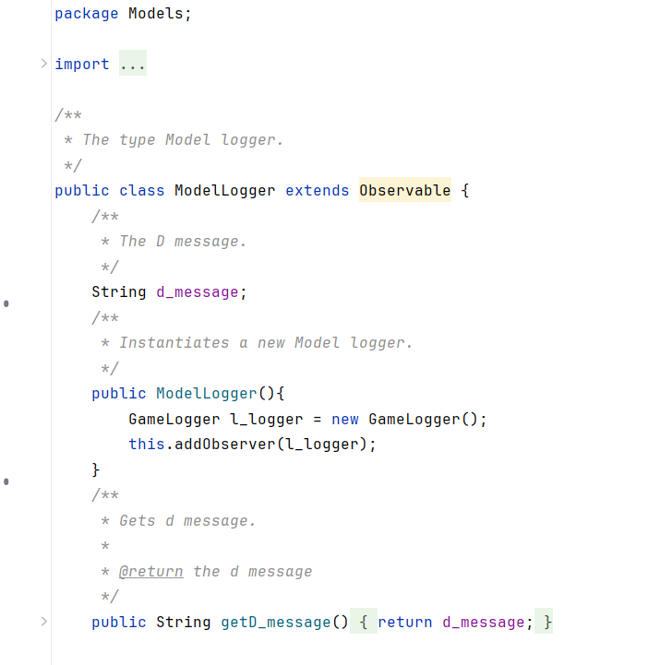
Architectural Design – Observer Pattern (Example)

Slide 11
JuNIT 4
JUnit 4 is a widely used testing framework for Java programming.
It allows developers to write repeatable tests for their code, ensuring that the program logic works as expected .
JUnit 4 is a popular testing framework for Java that offers several benefits:
Code Organization: JUnit can help you keep your code organized and easy to read.
Error Detection: JUnit can help you detect and fix errors in your code.
Quality Improvement: JUnit can help you improve the quality of your software.
Efficiency: Junit can help you work more efficiently and improve your testing process.

Slide 12
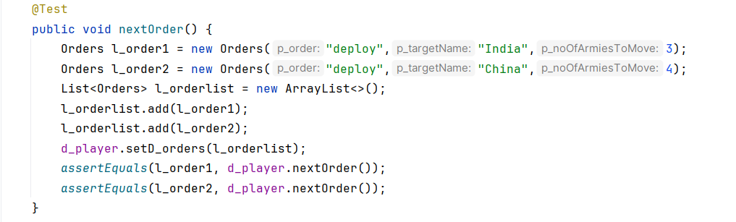
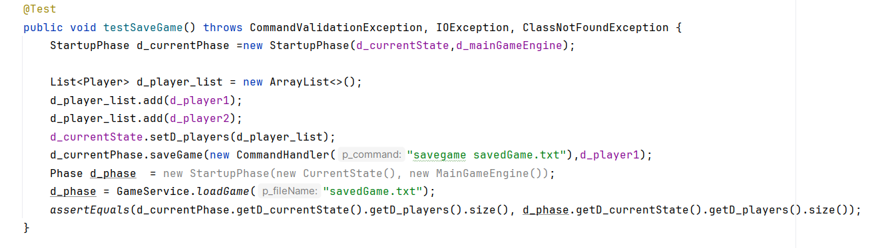
JuNIT TEST CASE EXAMPLES

Slide 13
TEST CASES
Map Validation:
Ensure map is a connected graph
Reading an Invalid Map File:
Test reading a map file with invalid format
Validation of a Correct Startup Phase:
Confirm correct allocation of initial armies
Test distribution of territories among players
Calculation of Number of Reinforcement Armies:
Validate calculation based on territories owned
Order Validation Upon Execution:
Test source/target validation for each order type (e.g., bomb, airlift)
Validate moving armies in the conquered country after conquering

Slide 14
TEST CASES
Load Game:
Test Function to Load a Game from Saved File
Save Game:
Test Function to Save current Game into a File.
Tournament Mode:
Test Function for the execution of Tournament mode.

Slide 15
Architectural Design – COMMAND PATTERN
Command pattern consist of -
Invoker – This entity is tasked with creating the necessary command object to execute a particular operation.
Receiver - It refers to an entity that is affected or utilized during the execution of the command.
Command - This class outlines the operations that each command should handle, often implemented as an abstract class or interface.
ConcreteCommand - This object carries the context needed for executing operations and includes the code responsible for performing the actual operation.

Slide 16
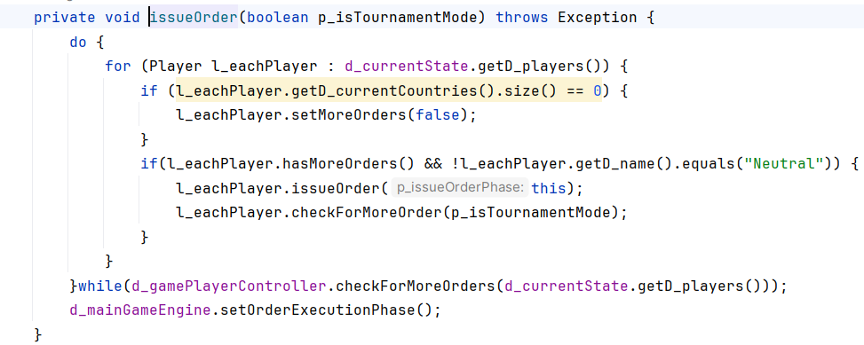
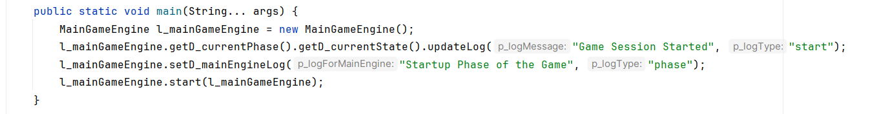
ARCHITEcTURAL DESIGN – COMMAND PATTERN (Example)

Slide 17
ARCHITECtURAL DESIGN – ADAPTER PATTERN
Context – An object is designed to conform to a specific interface, utilizing an Adapter to smoothly integrate and utilize functionality specific to that interface.
Interface - An abstract class or interface defines methods for adaptee classes, ensuring consistency in integration.
Adapter - Acts as a bridge, enabling the Context object to interact with adaptee functionalities through a common interface.
Adaptee - Housing existing functionality, it requires an Adapter for compatibility during integration.
Benefits - It promotes code flexibility and modularity, enabling seamless interaction between the Context object and a variety of adaptee classes.

Slide 18
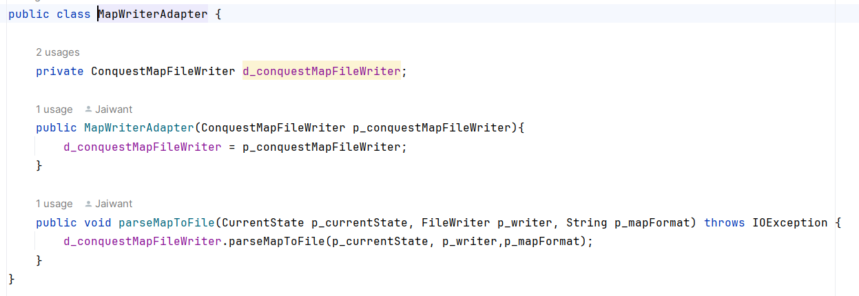
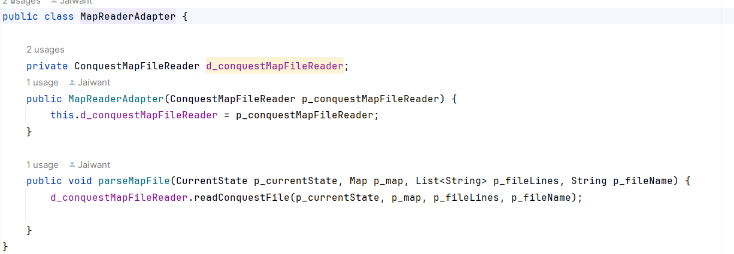
ARCHITECTURAL DESIGN – ADAPTER PATTERN (Example)

Slide 19
Player behaviour strategies in game dynamics
Human Player – Relies on user input for making decisions during gameplay.
Aggressive Computer Player - Concentrates forces and prioritizes attacking with the most powerful country while aiming to maximize troop accumulation.
Benevolent Computer Player - Concentrates on defending vulnerable countries and prioritizes reinforcing existing territories instead of initiating attacks.
Random Computer Player - Randomly deploys armies, conducts attacks, and moves troops within the game environment.
Cheater Computer Player - Focuses on quickly conquering nearby adversaries and doubles the number of troops on territories bordered by enemy-held regions, directly influencing the map during the creation of orders.

Slide 20
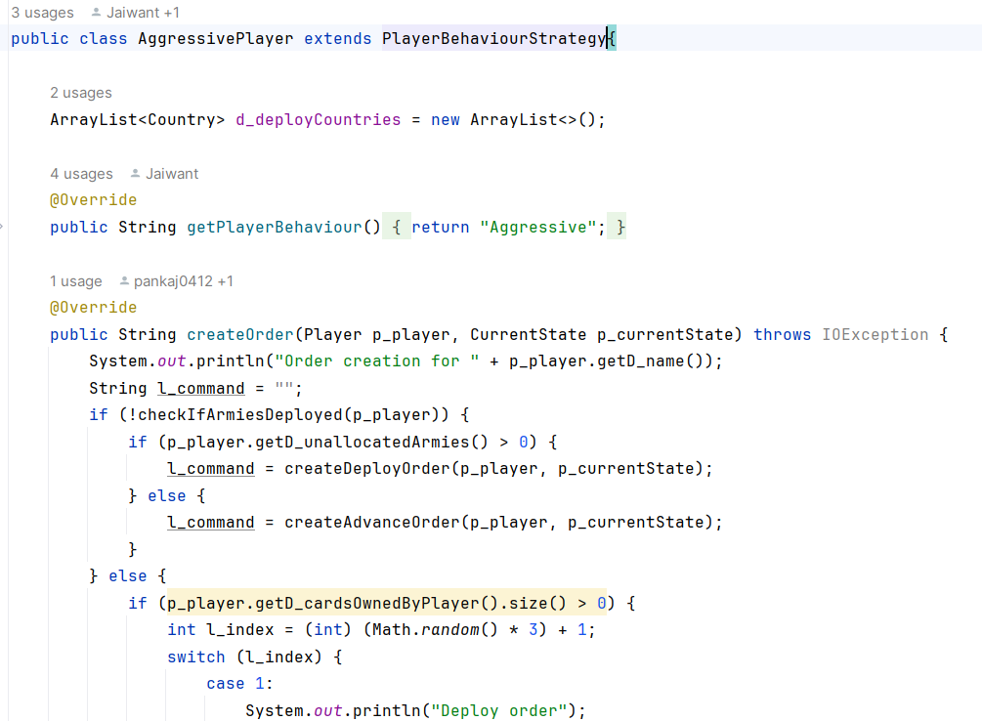
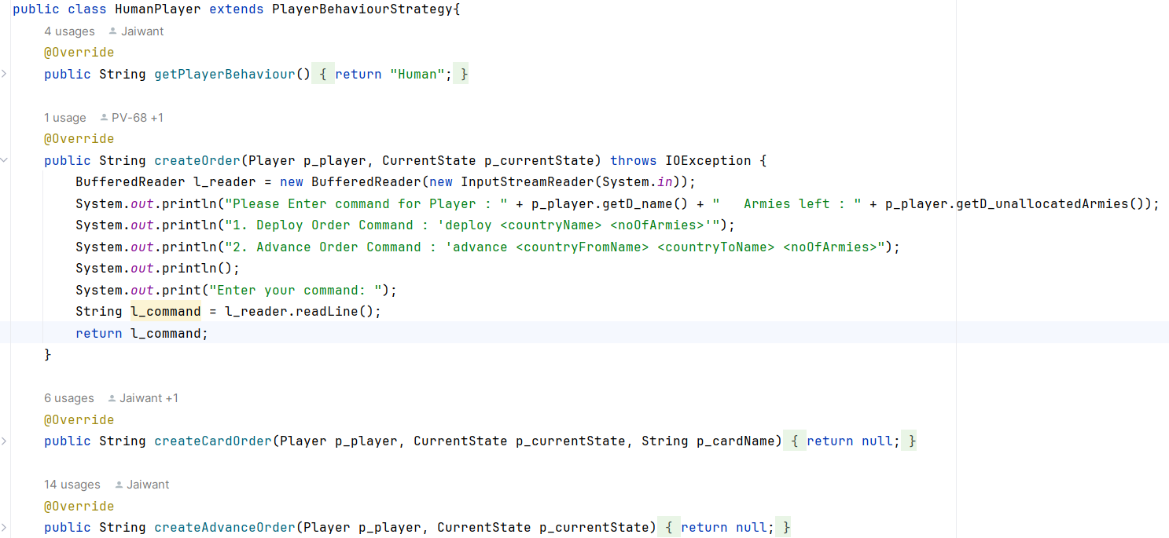
Player behaviour strategies
(CODE SNIPPETS)

Slide 21
TOURNAMENT MODE OVERVIEW
Tournament Configuration–
User can customize their gaming experience by selecting the number of maps (M) from 1 to 5, choosing 2 to 4 player strategies (P), specifying the number of games (G) per map within a range of 1 to 5, and determining the duration of each game (D) ranging from 10 to 50 turns.
Automatic Tournament Execution-
The system runs G games on each of the M maps utilizing selected computer player strategies, with gameplay being automated without requiring user input. Draws are announced once D turns are completed to reduce the time taken for each run.

Slide 22
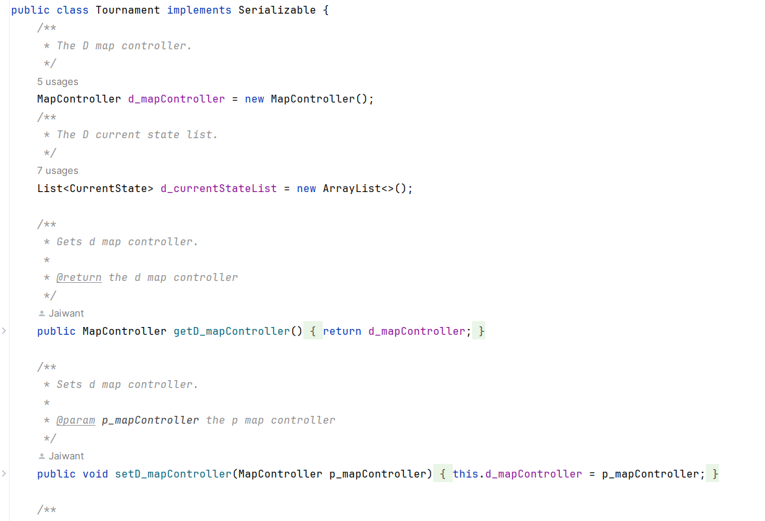
TOURNAMENT MODE OVERVIEW (CODE SNIPPET)

Slide 23

THANK YOU

